Slide 1
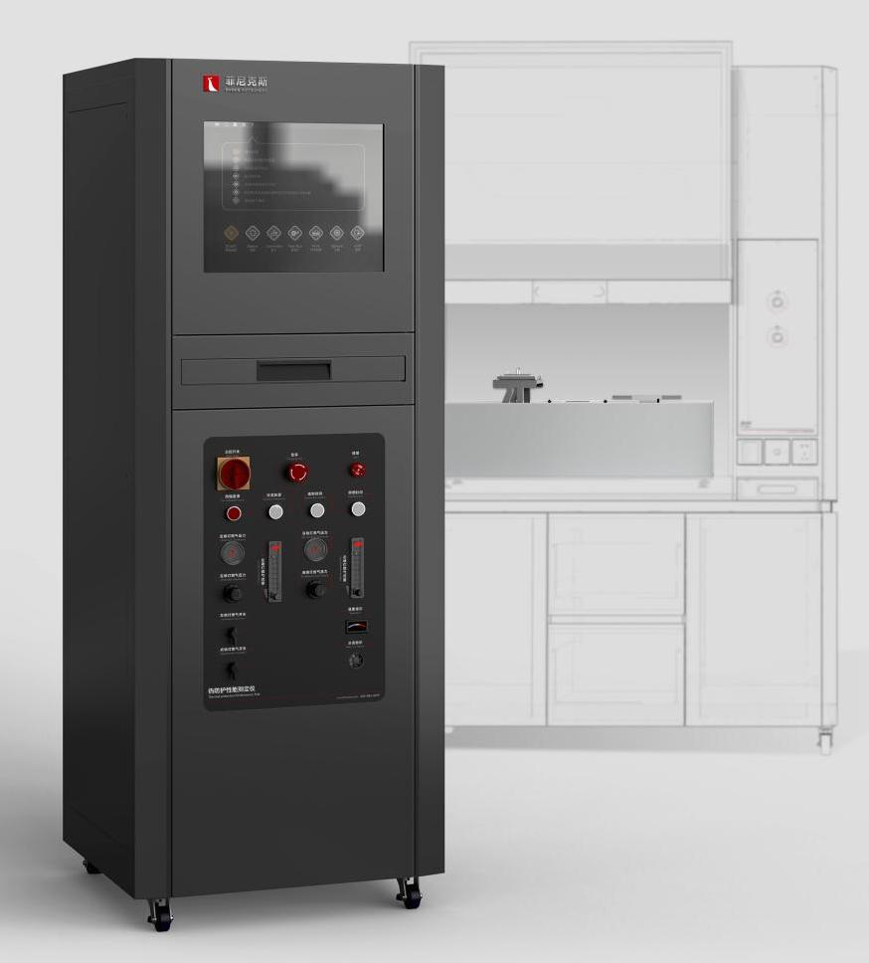
The Expert In Fire Testing
TPP Thermal Protection Performance Tester
TPP thermal protection index tester is used to test the thermal protection performance of protective clothing, safety shoes, gloves, helmet outer surface, etc. The thermal protection performance of the material is tested under the action of a given heat source.
Product Standard
NFPA 1971: Standard for the full suit test for fire and similar fire services
ASTM D4018: Standard Test Method for Properties of Continuous Filament Carbon and Graphite Fiber Bundles
GB 8965.1-2009: Technical requirements, inspection (test) methods and inspection rules for flame retardant clothing
Product Parameter
Model PX04006
Combustion Cabinet：750(W)×300(D)×900(H)mm
Console Cabinet：650(W)×650(D)×1600(H)mm
Power Supply AC 220V, 50Hz, 16A
Weight APPR. 180kg
Gas Source More than 95% purity propane gas
Dimension
Feature
Aluminum alloy structure anti - testing chamber body, stable structure, beautiful and generous
Independent control cabinet, convenient for laboratory layout, and away from fire to avoid the influence of high temperature on the electrical components of control room
It is equipped with two 45-degree Meker burners with 38mm inner pipe diameter and 5/16 inch inner hole diameter, which can provide 25KW heat output. The mouth of the burner is a metal mesh structure, and the lower air valve of the burner can be adjusted to adjust the mixing ratio of air and gas
The burner is automatically ignited by high pressure pulse, which is stable, safe and reliable
Equipped with water-cooled heat flow meter, working range of 0-100 kW/㎡, heat flow meter accuracy &lt; ±3%, the response time is 0.2s, the emissivity is greater than 0.95, and the output signal is greater than 5mV within the working range
Provide portable cooling water source without external water connection
Imported OMEGA thermocouple + temperature measuring steel plate for temperature calibration, temperature acquisition system display accuracy of 0.1℃, range of 0-1000℃
Equipped with aluminum water cooling plate for auxiliary heat dissipation, size of 340*286mm
Equipped with chiller feed cold plate for heat exchange, water flow 10L/min
Jiangsu Firemana Safety Technology Co., LTD
www.firemana.com
Add: D3 Safe Valley Of China, Tongshan District, Xuzhou City, Jiangsu Province,China
0516-83843888
400-086-0699

Slide 2
The Expert In Fire Testing
Continued Page
Equipped with imported precise rotor flowmeter to control gas and air flow
Equipped with brand pressure gauge and pressure regulating valve to adjust gas pressure, equipped with solenoid valve to control gas on and off, to ensure the safety of equipment
Nine T150 quartz infrared tube arrays can provide a heat radiation flux of 13KW/㎡±4 KW/㎡
Under the heat radiation of quartz infrared tube, the total heat flux can be set to 84KW/㎡± 2kW /㎡ by adjusting the gas supply to Meker burner
The water cold plate can be quickly moved to the use position and evacuated by electric module
The sample device is made of stainless steel
The test sample can be quickly moved to the use position and evacuated by electric module
The self-designed standard electrical cabinet, built-in 19-inch touch control all-in-one, equipped with programmable controller (PLC) control system, based on NI Labview platform PC software, to achieve test function control, curve display, real-time data view, save and report output and other functions.
Jiangsu Firemana Safety Technology Co., LTD
www.firemana.com
Add: D3 Safe Valley Of China, Tongshan District, Xuzhou City, Jiangsu Province,China
0516-83843888
400-086-0699

